Slide 1



Implementing NICE Tirzepatide: A Step-by-Step Guide for General Practice
Dr Elziabeth Uchegbu
Consultant Endocrinologist, BHNFT
SY Diabetes Clinical Lead, SY ICB
Special Interest in Weight Management
Feb 2026

Slide 2

Session Objectives
Apply the Tirzepatide Rollout Priority Cohorts and identify eligible patients.
1
Complete a safe pre-initiation assessment and confirm wraparound support.
2
Apply NICE overweight and obesity guidance to deliver patient-centred care, tailoring support to individual circumstances and preferences.
3
Monitor outcomes and apply stop/down-titrate as set out in SY Tirzepatide guidance when required.
5
Start and TITRATE Tirzepatide safely, managing adverse effects.
4

Slide 3

Session Outline
Obesity as a long-term condition
Clinical Relevance of Obesity in UK Primary Care
Weight Loss Pharmacological Therapies and their MOA in the 21st Century
Tirzepatide basics: pharmacology, evidence and expectations
SY Tirzepatide Pathway – Patient selection and pre-initiation assessment
Starting treatment: shared decision-making and initiation appointment
Follow-up: titration, side-effects, stopping and diabetes-specific considerations
Specialist Clinical Support
Governance

Slide 4






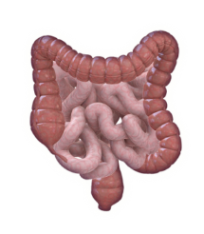


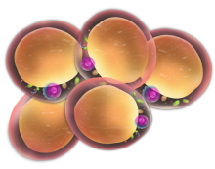
Obesity: a complex, multifactorial disease: Adaptive mechanisms protect weight gain
A CALORIE IS A CALORIE
Energy intake
Energy expenditure
Hedonic input
Environment
Experienced palatability or pleasure
Inactive lifestyle, smoking cessation, psychosocial factors
Adipose tissue
Pancreas
Gut
Genetics
Medications
Notes:
At this point, I like to bring it back to basics — not to patronise, but to re-frame. I usually say something like, ‘We all know the energy balance model, but NG246 reminds us that while it's physiologically true, it's psychologically incomplete.’ This opens the door to acknowledging that biological compensatory mechanisms — hormonal, neurological — work against sustained weight loss, which is why lifestyle-only approaches often fail long-term. It sets up the rationale for pharmacotherapy and MDT involvement.
Here I lean into the language change. Obesity isn't being described as behaviour-driven but biology-influenced. I often say — ‘If this were asthma, we wouldn’t tell patients to breathe harder.’ It gets a small laugh but lands the point. NICE uses terms like ‘relapsing’ and ‘chronic’ deliberately. The aim here is to help GPs shift from motivational interviewing alone to structured medical intervention pathways

Slide 5
Obesity = Long-term health condition
Guidelines define it as chronic, relapsing, progressive(NICE NG246)
Following weight loss, compensatory appetite-hormone adaptations can increase hunger and may persist for ≥12 months¹.
At the same time, energy expenditure can fall more than expected for the new body size often called metabolic adaptation (adaptive thermogenesis) which can make weight regain easier without ongoing support².
Longer-term follow-up data also show resting metabolic rate may remain suppressed years later, consistent with persistent metabolic adaptation³.
Stopping treatment commonly leads to weight regain
Clinical implication for primary care: treat like other LTC – structured follow-up, maintenance planning, escalation/de-escalation rather than “one episode of advice”
Sumithran P, Prendergast LA, Delbridge E, Purcell K, Shulkes A, Kriketos A, et al. Long-Term persistence of hormonal adaptations to weight loss. New England Journal of Medicine [Internet]. 2011 Oct 26;365(17):1597–604. Available from: https://doi.org/10.1056/nejmoa1105816
Rosenbaum M, Leibel RL. Adaptive thermogenesis in humans. Int J Obes (Lond). 2010 Oct;34 Suppl 1(0 1):S47-55. doi: 10.1038/ijo.2010.184. PMID: 20935667; PMCID: PMC3673773.
Fothergill E, Guo J, Howard L, Kerns JC, Knuth ND, Brychta R, Chen KY, Skarulis MC, Walter M, Walter PJ, Hall KD. Persistent metabolic adaptation 6 years after "The Biggest Loser" competition. Obesity (Silver Spring). 2016 Aug;24(8):1612-9. doi: 10.1002/oby.21538. Epub 2016 May 2. PMID: 27136388; PMCID: PMC4989512.

Slide 6
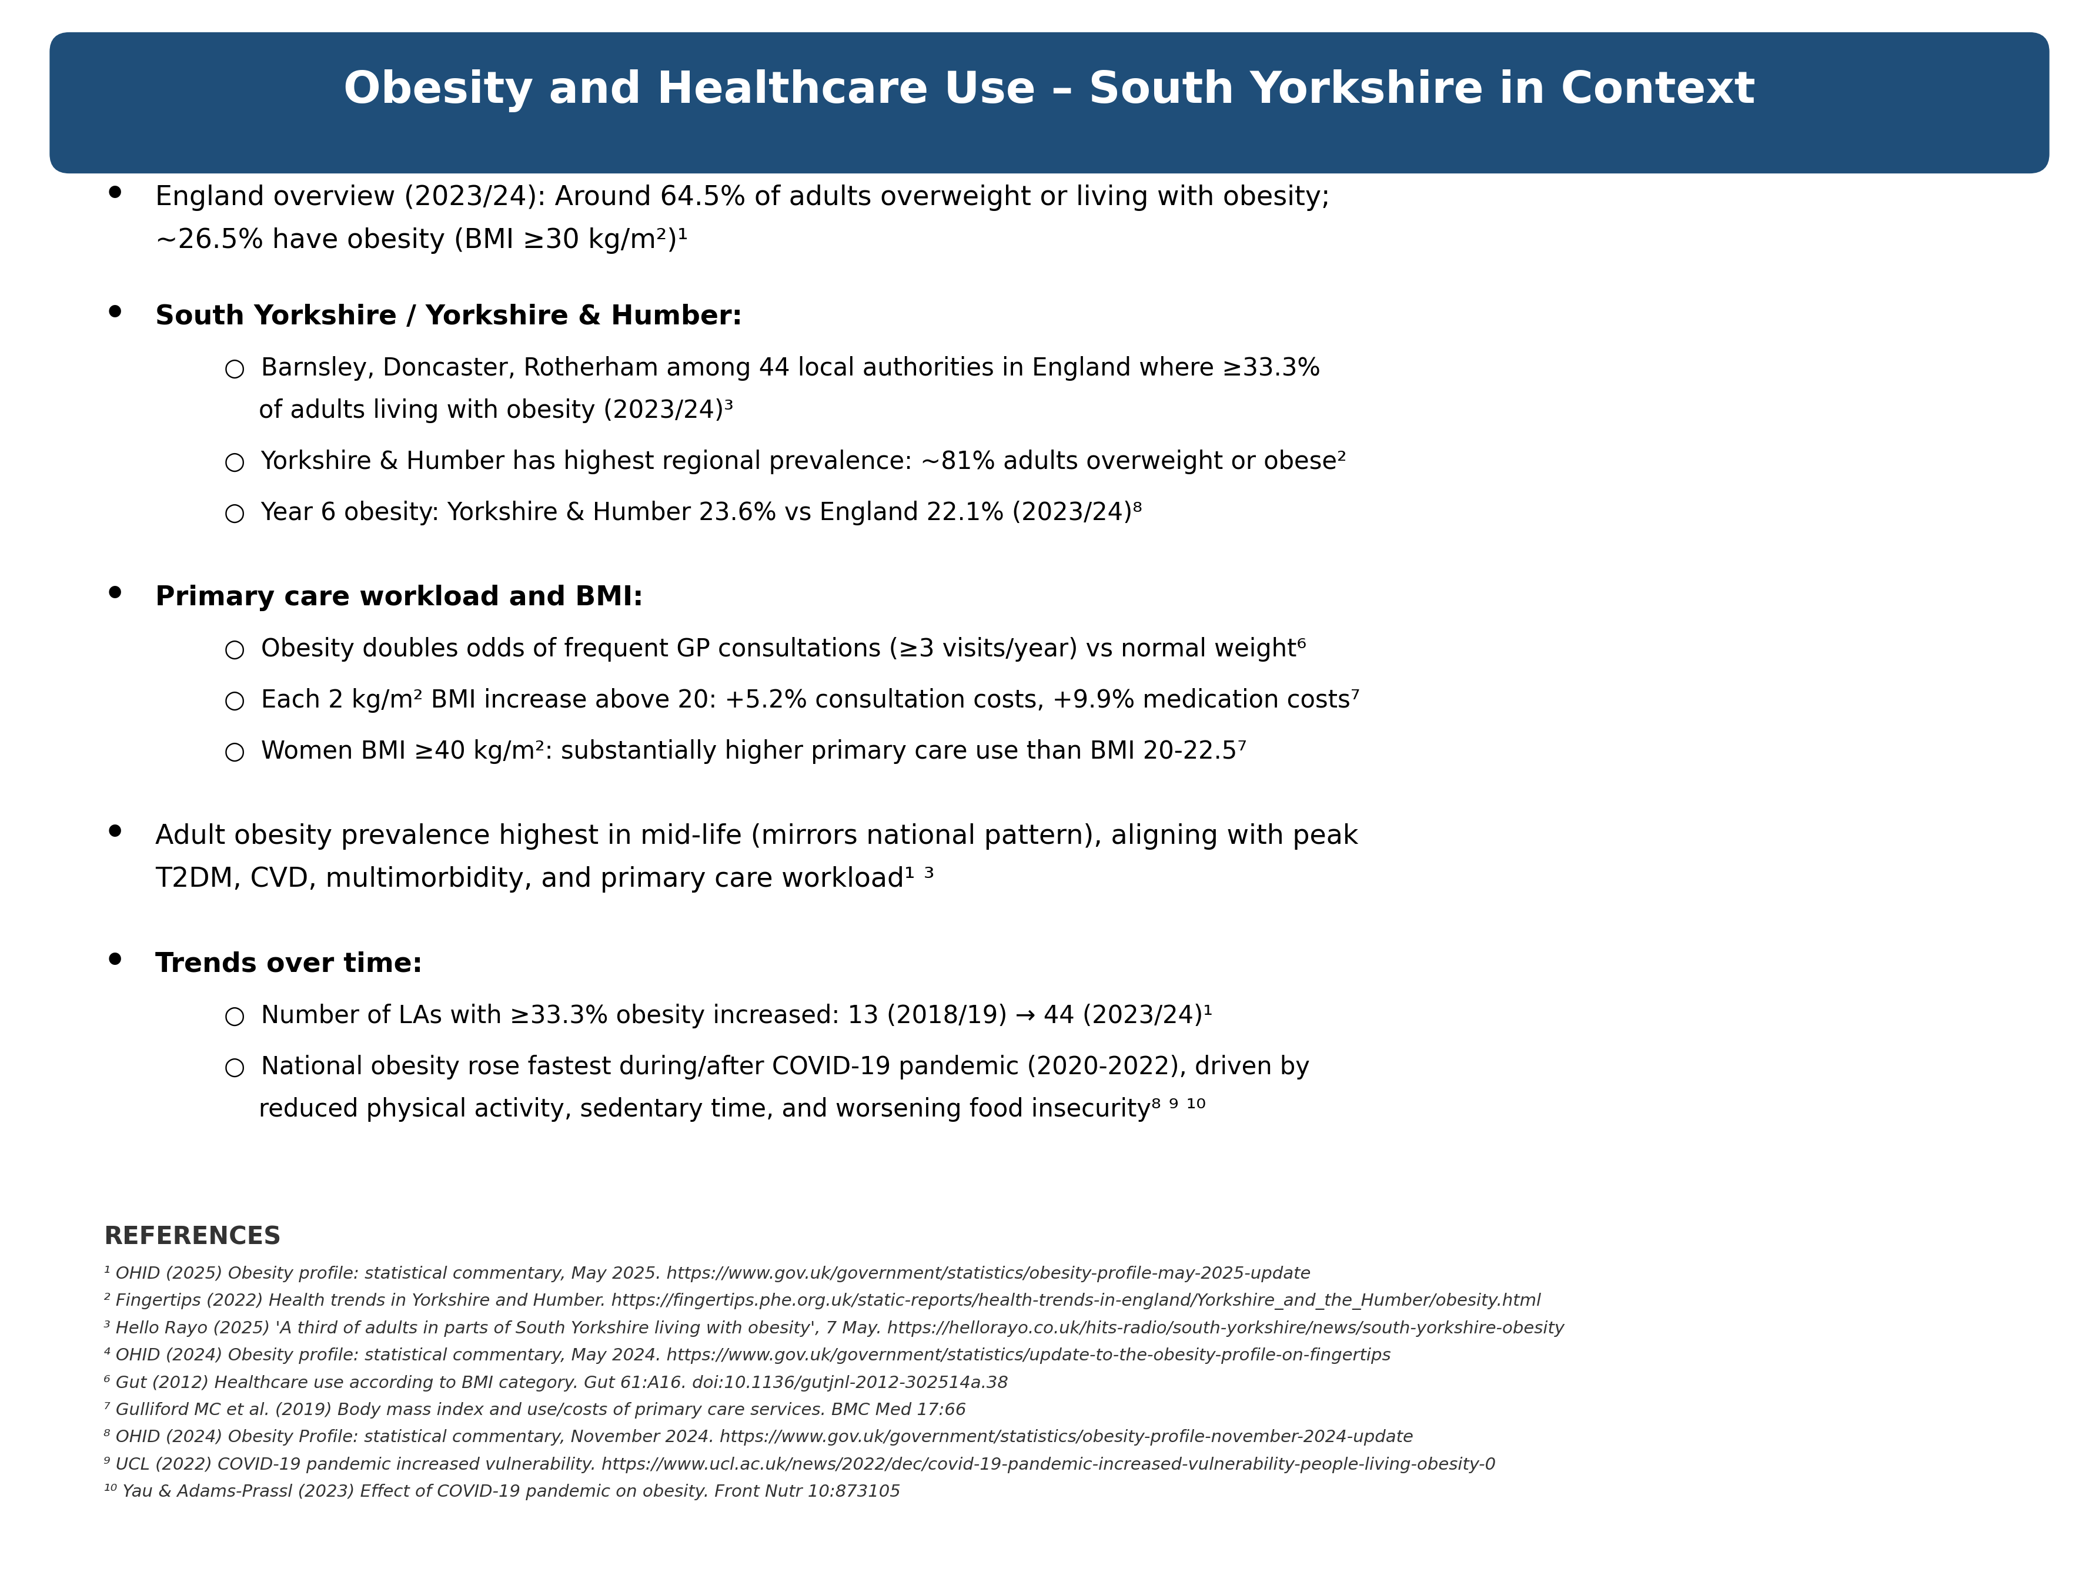

Slide 7
Consequences of excess weight in GP Practice
BMI Category (kg/m²) | Mean GP Consultations/Year (Women 55–79y) | Mean Annual Cost (2016 £)
20 to <22.5 | 7.0 (6.8–7.1) | £288 (280–295)
22.5 to <25 | 7.1 (7.0–7.3) | £296 (289–302)
25 to <27.5 | 7.5 (7.4–7.7) | £314 (307–321)
27.5 to <30 | 8.1 (7.9–8.3) | £338 (329–347)
30 to <35 | 9.0 (8.7–9.2) | £376 (366–386)
35 to <40 | 10.1 (9.7–10.5) | £428 (410–447)
≥40 | 11.1 (10.3–11.9) | £473 (441–506)

Slide 8
Obesity Management: What changed in the last decade (≈2016–2026)
Reframed as a chronic, relapsing disease → long‑term care, not “willpower”.^{1,2}
Pathways matured: tiered specialist services + digital/remote programmes.^{3,4}
Therapeutics step‑change: high‑efficacy incretin meds (Semaglutide ~15%; Tirzepatide up to ~21% weight loss in RCTs).^{5,6,7}
Guidelines/commissioning shifted: NICE recommends AOMs within structured services; NHS England is phasing rollout by clinical risk.^{2,6,8}
More outcomes + equity focus: prevent complications and narrow inequality gaps as prevalence rises and remains socially patterned.^{2,9}
¹ World Health Organization (WHO). Obesity and overweight – fact sheet (updated 8 Dec 2025).
² NICE. NG246 Overweight and obesity management (published 14 Jan 2025; updated 8 Jan 2026).
³ NHS England. Enhanced service specification: Weight management 2021/22 (B0699, published 21 Jun 2021).
⁴ NHS England. NHS Digital Weight Management Programme: Healthcare professional toolkit (2022).
⁵ Wilding JPH, et al. Once-weekly semaglutide in adults with overweight or obesity (STEP 1). N Engl J Med. 2021.
⁶ NICE. TA875 Semaglutide for managing overweight and obesity (published 8 Mar 2023; updated 4 Sep 2023).
⁷ Jastreboff AM, et al. Tirzepatide once weekly for the treatment of obesity (SURMOUNT‑1). N Engl J Med. 2022.
⁸ NHS England. Interim commissioning guidance: implementation of NICE TA1026 (tirzepatide) (published 24 Mar 2025).

Slide 9
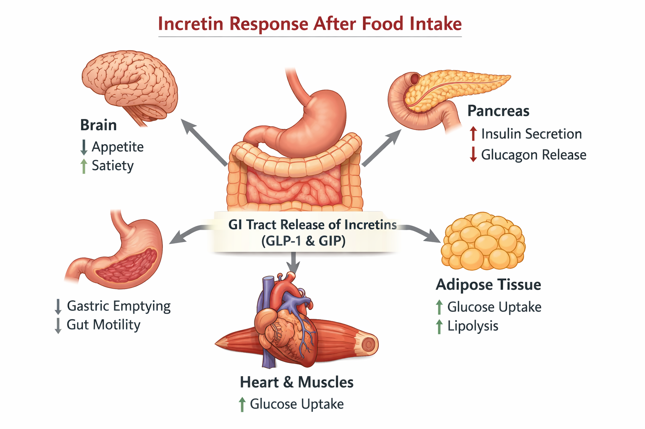
Incretin Mimetics- What are they?
Mimic natural gut hormones (GLP-1, and/or GIP) released after eating—these are called incretins. Normal physiology: Meal Meal → GLP‑1/GIP ↑ insulin (glucose‑dependent), ↓ glucagon, slow gastric emptying, ↑ satiety.
GLP 1 – Liraglutide, Semaglutide ; Dual GIP/GLP-1 - Combine enhanced insulin response with synergistic weight loss via both incretin pathways – Tirzepatide.
Lower blood glucose, support sustained weight loss, and often improve cardiovascular(Liraglutide, Semaglutide), and metabolic risk factors

Slide 10
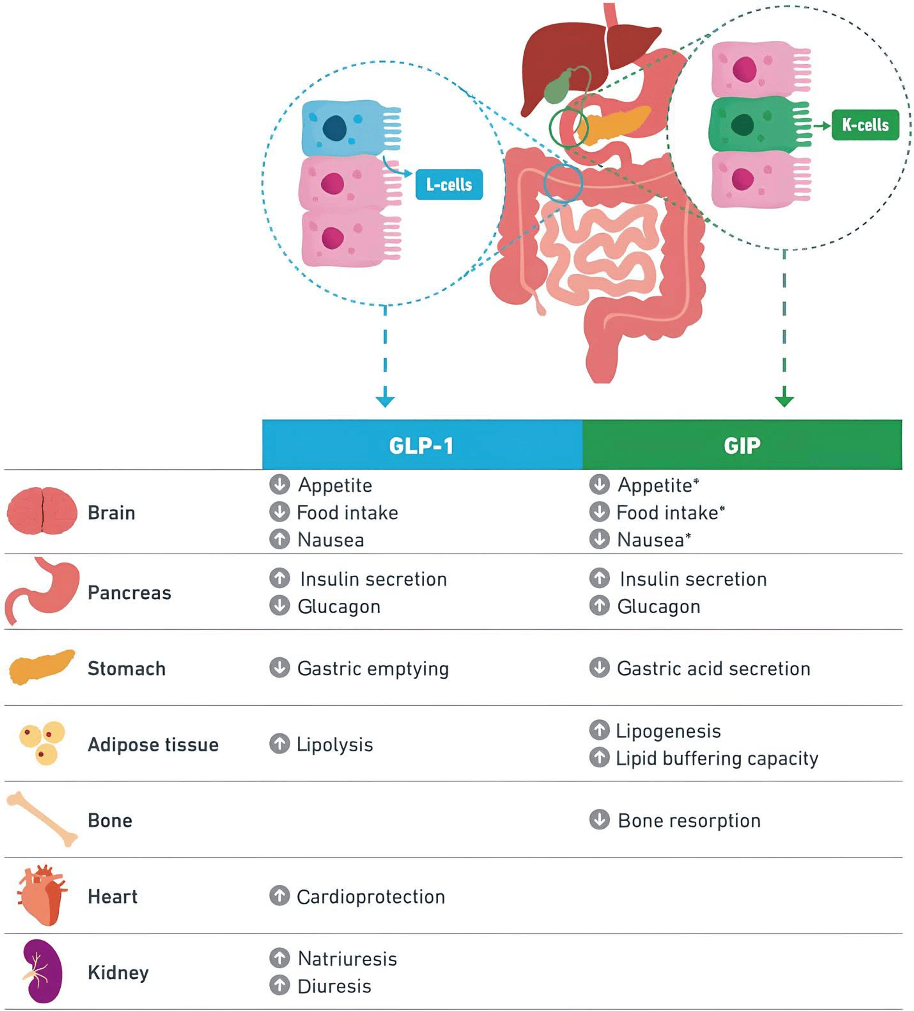
The dual agonist action of Tirzepatide on various organs

Slide 11
Why Tirzepatide now?
Obesity burden → Inequalities → Evidence → Policy rationale
Burden: 64.5% adults overweight/obese; 26.5% obese (2023/24) → multimorbidity + ↓QoL.¹,²
Inequality: obesity highest in deprivation (37.4% vs 19.8% least deprived); LAs with ≥33.3% obesity: 13 → 44 (2018/19 → 2023/24).¹³
Efficacy: Tirzepatide + Lifestyle ~15–21% loss at 72w (SURMOUNT‑1) + extra ~18% after intensive lifestyle (SURMOUNT‑3).⁴,⁵
Downstream risk: post‑hoc/modelled projections suggest larger 10‑year reductions in CVD and T2D risk.⁶
Economics & equity: UK models find cost‑effective (often dominant) vs Liraglutide and vs Lifestyle; equity depends on access by need.^{⁹,¹⁰,¹¹}
Guidance: NICE TA1026 recommends in high BMI + comorbidities; NHS England is phasing rollout via structured services, prioritising highest risk._{⁷,⁸}
¹ OHID. Obesity profile: short statistical commentary (May 2025).
² UK Parliament. Obesity statistics briefing (Feb 2025).
³ Press report summarising OHID Active Lives local authority estimates (May 2025).
⁴ Jastreboff AM, et al. N Engl J Med. 2022 (SURMOUNT‑1).
⁵ Wadden TA, et al. Nat Med. 2023 (SURMOUNT‑3).
⁶ Mamas MA, et al. Eur Heart J Open. 2025;5(5):oeaf117 (SURMOUNT‑5 post‑hoc).
⁷ NICE. TA1026 (published Dec 2024; updated Sep 2025).
⁸ NHS England. Interim commissioning guidance for TA1026 (Mar 2025).
⁹ Capehorn M, et al. UK cost‑effectiveness vs liraglutide. 2025.
¹⁰ Johansson G, et al. ISPOR Europe 2024 (UK model vs lifestyle).
¹¹ NICE TA1026 economic model.

Slide 12
Evidence for Tirzepatide Use
SURMOUNT-1 trial: Tirzepatide resulted in ~20% mean body weight reduction at 15mg dose, outperforming placebo and semaglutide.
Significant improvement in comorbidities: blood pressure, lipids, prediabetes reversal, and CV risk indicators.
Available for adults with BMI ≥35 kg/m² plus ≥1 comorbidity, or lower BMI for eligible ethnicities.
Review at 6 months: stop if <5% weight loss at max tolerated dose – see NICE caveat.
Most common adverse effects: GI symptoms (nausea/diarrhoea), usually mild and transient.
Weight regain expected after stopping; ongoing support is essential.

Slide 13
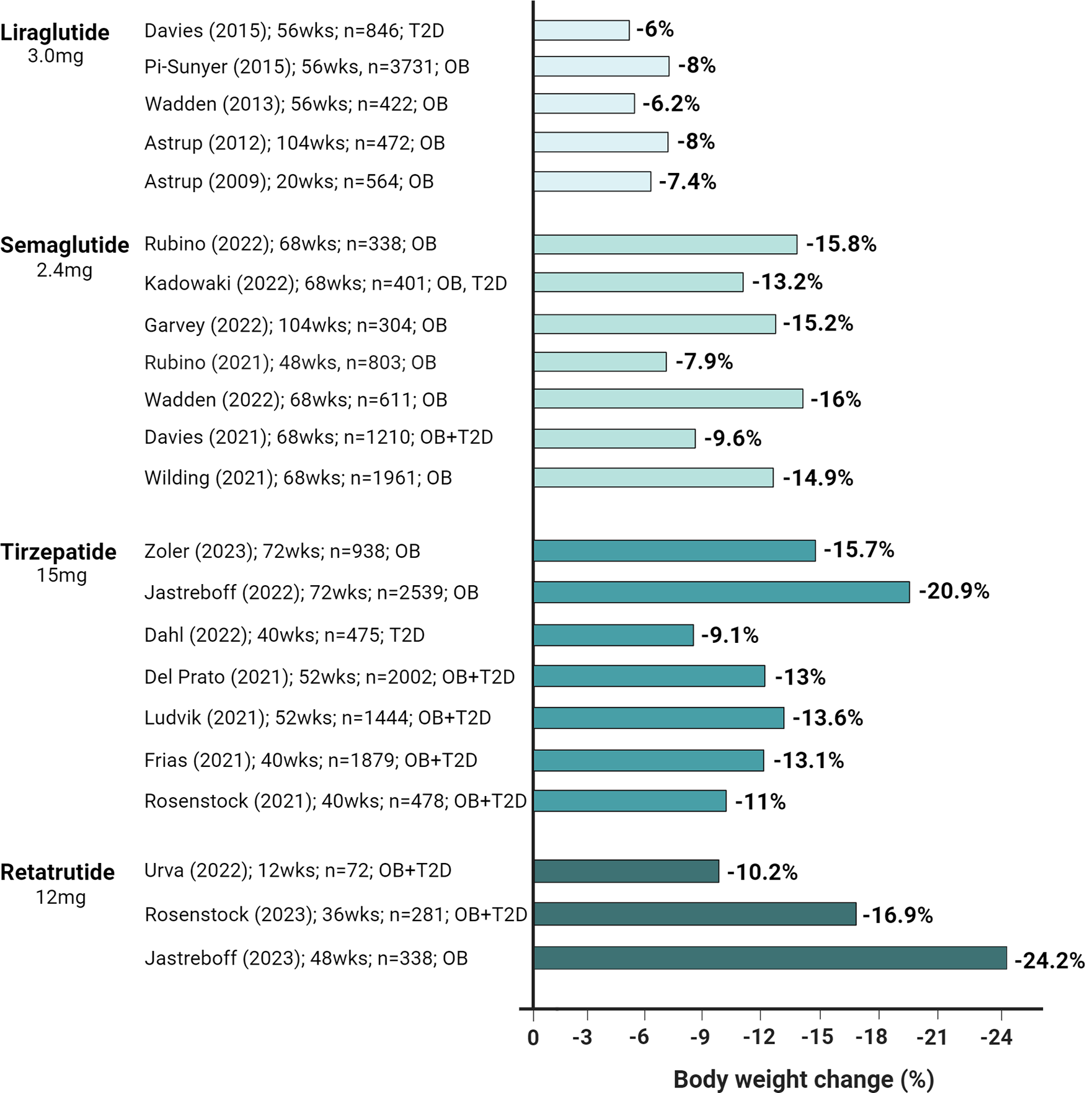

Impact of Lira, Sema, Tz, and retatrutide on body weight in randomized controlled trials. OB, obesity; T2D, type 2 diabetes.
Diabetes Care. 2024;47(10):1718-1730. doi:10.2337/dci23-0100
Impact of Lira, Sema, Tz, and retatrutide on body weight in randomized controlled trials. OB, obesity; T2D, type 2 diabetes.
Date of Download: 10/11/2025
Copyright © 2025 American Diabetes Association. All rights reserved.

Slide 14
TIRZEPATIDE TA 1026
12-year phased rollout: first 3 years target highest-risk patients, then expand as capacity allows.
Initial priority: adults with BMI ≥40 plus multiple comorbidities; thresholds lowered progressively and for some ethnic groups.
All prescriptions must include structured behavioural, dietary and activity support.
Review at 3 years, then ongoing audit of effectiveness, uptake, cost and safety to guide commissioning.
Aim to reduce health inequalities by prioritising high-need groups and ensuring fair national access.

Slide 15
NHS Tirzepatide Rollout: Priority Cohorts (Years 1–3)
Cohort 1
Cohort 2
Cohort 3
YEAR 1 (2025/26)
YEAR 2 (2026/27)
YEAR 2/3 (2026/27–2027/28)
• BMI ≥ 40 kg/m²
• ≥ 4 qualifying comorbidities
• Duration: 12 months
• BMI 35.0–39.9 kg/m²
• ≥ 4 qualifying comorbidities
• Duration: 9 months
• BMI ≥ 40 kg/m²
• ≥ 3 qualifying comorbidities
• Duration: 15 months
Duration: 12 months
Duration: 9 months
Duration: 15 months
Qualifying Comorbidities
ASCVD/Established CVD- IHD, CVD, PVD, Heart failure,
Hypertension – Established diagnosis on treatment, or meets NICE NG136 but declines medication
Dyslipidaemia – Treated or OR LDL ≥4.1 mmol/L, OR HDL <1.0 mmol/L (men) or <1.3 mmol/L (women), OR fasting triglycerides ≥1.7 mmol/L
Obstructive sleep apnoea (OSA) – Severe enough to be eligible for CPAP
Type 2 Diabetes Mellitus
Equity adjustment: BMI threshold lowered by 2.5 kg/m² for specified ethnic groups
Source: NHS England interim commissioning guidance for NICE TA1026 (tirzepatide for weight management)

Slide 16
Tirzepatide Roll Out – South Yorkshire
Robust governance: robust clinical guideline, pathway and operating guidance
Phased rollout: Cohort based , linked to mandated wraparound support
Primary care-led delivery: GP assessment, initiation oversight and ongoing monitoring/review
Wraparound first: behavioural support must start before the first prescription is issued
Structured Follow-up: structured titration and follow up schedule through to maintenance and after completing treatment
Defined stopping rules: clear discontinuation criteria, maximum treatment duration (2 years ) and 1 year post treatment support plan

Slide 17
Working the Pathway – ELIGIBILITY AND ASSESSMENT FOR TIRZEPATIDE

Slide 18
Step 1: Eligibility

Slide 19
Operationalising Tirzepatide Eligibility (SystmOneEMIS)
SY ICB searches may be available, but depends heavily on accurate clinical coding.
Incorrect or incomplete coding may mean eligible patients are missed.
Code co-morbidities accurately to ensure correct eligibility and payment.
For people living with diabetes, make sure all key care processes are completed and recorded.
Validate the active cohort and apply current ICB eligibility rules(e.g. Cohort 1 : BMI ≥ 40 + ≥ 4 qualifying comorbidities

Slide 20
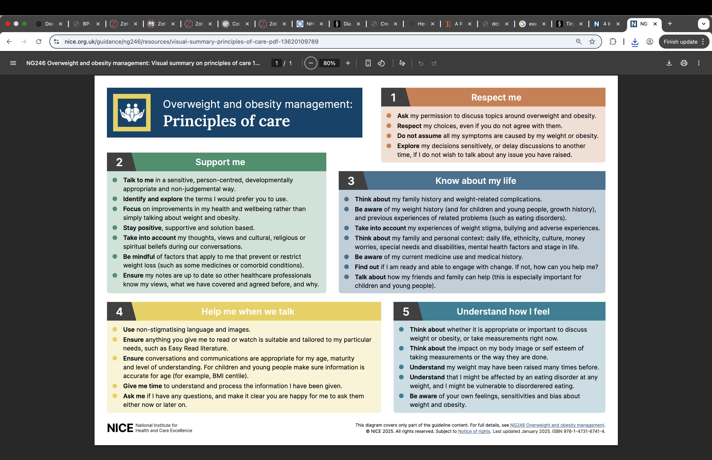
Step 2 Assessment

Slide 21
Stage pathway | Mins | First 12 months (4 weekly) |  |  |  |  |  |  |  |  |  |  |  |  | Second 12 months (quarterly)
 |  | 1 | 2 | 3 | 4 | 5 | 6 | 7 | 8 | 9 | 10 | 11 | 12 | 13 | 3 | 6 | 9 | 12
Initial Assessment | 30
Baseline measurements | 10
Commencement app | 30
Reviews & titration | 15
6 months max tolerated review | 20
Maintenance reviews | 15
Measurements/bloods | 10
Annual review | 20
NB: The timing of the six months post maximum tolerated dose review will vary between patients depending on how quickly they have been titrated and the maximum dose achieved. The appts coloured: Blue must be face to face appts (unless exceptional circumstances). Green - for the remaining 4 weekly reviews, it is up to clinical judgement and patient wishes as to whether some of them could be done remotely, with the patient recording their weight 4 weekly either at home or in the practice (e.g. if the practice has a weighing scale in the wating room). But as a minimum, the patient must be reviewed face to face and have a HCP recorded weight documented at least three monthly. Orange - If continuing tirzepatide beyond the six-month maximum tolerated review, a minimum of quarterly reviews face to face with HCP recorded weights are needed. Bloods and baseline measurements may be undertaken by a healthcare assistant. All other appointments must be undertaken by appropriately trained and qualified prescribing health care professionals.

Slide 22
Case 1 : Mr AZ
- Age: 44years
- BMI: 44.2kg/m² (Class III Obesity)
- Weight: 120.4kg, Height: 165cm
- Lives with wife and 2 children
- Unemployed – long-term sick – back pain
Medical Background
Type 2 Diabetes Mellitus diagnosed 01/2017
Non-Alcoholic Fatty Liver Disease
Chronic Viral Hepatitis B
Stable Angina
Hypertension
Tumour of Nasal Cavity , surgery 2020
Obstructive Sleep Apnoea
Mixed Anxiety and Depression
Hyperlipidaemia
Medications
Mounjaro 5mgs
Amlodipine 10mgs od
Aspirin Dispersible 75mgs od
Bisoprolol 5mgs od
GTN Spray PRN
Metformin 1grams bd
Omeprazole GR 20mgs od
Ramipril 2.5mgs od
Sertraline 100mgs od
Naproxen 250mgs bd prn
Age - young age , potential to benefit the most
Assess exercise capacity
Assess the severity of Angina
H/o Liver disease – check LFTs, Vitamin D level , B12 and Folate
Check for history of Gall stones, alcohol use , smoking history
Patient Already on Mounjaro – review efficacy in lowering HbA1c/Weight
Note – history of nasal cavity cancer – confirm remission/cure

Slide 23
Case 2: Mr MK
- Age: 66years
- BMI: 46.8kg/m² (Class III Obesity)
- Weight: 143.4kg, Height: 175cm
- Lives with partner, uses Zimmer indoors and wheel chair outside
Medial Background
Type 2 Diabetes diagnosed 06/2012
Severe Obstructive Sleep Apnoea
Degenerative Arthritis
Gout
CVA – Past haemorrhagic Stroke
Atrial Fibrillation
IHD with past MI
Heart Failure
Chronic Bilateral Leg Oedema
CKD 3 and Microalbuminuria
Hypertension
Medications
Novomix 30 30units AM and 30units PM
Lisinopril 20mgs od
Lansoprazole GR 30mgs od
GTN Spray PRN
Gabapentin 300mgs tds
Furosemide 80mgs AM and 40mgs PM
Ezetimibe 10mgs Nocte
Digoxin 187.5micrograms od
Bisoprolol 7.5mgs od
Atorvastatin 80mgs nocte
Apixaban 5mgs bd
Amitriptyline 25mgs nocte
? Frail
Heart failure – high dose diuretics, digoxin
May required supervised physical activity - ? Refer to physio
On Novomix 30 only - ? Optimise diabetes control
? Start GLP 1 for diabetes management at first instance and monitor
Older patient, may not do well with rapid weight loss
Aim for not more than 2 pounds weight loss a week.
? Delay start

Slide 24
Case 3: Mr IM
Medications
Tirzepatide 5mgs weekly
Angitil SR 90mgs bd
Aspirin dispersible 75mgs od
Atorvastatn 40mgs nocte
GTN Spray PRN
Testogel as directed
Ramipril 10mgs od
Symbicort 200/6 mcg per dose as directed
Yaltormin SR 1grams bd
- Age: 55years
- BMI: 47.56kg/m² (Class III Obesity)
- Weight: 152.4kg, Height: 179cm
- Lives with wife and 2 adult children
- Take away shop owner
Medial background
Type 2 Diabetes Mellitus diagnosed in 04/2017
Hypogonadism
Diabetic Retinopathy
Artheroma
Hypertension
Eligible
Screen for OSA
Already on Tirzepatide 5mgs for Diabetes –
on enrolling can titrate to 7.5mgs OW, not necessary to start at the lowest dose
Assess the severity of angina
High baseline weight – likely more rapid weight loss
Optimise protein intake to minimise loss of lean body mass

Slide 25
Case 4: Mr MM
Medications
Ozempic 1mgs ow
Amitriptyline 10mgs od
Atorvastatin 40mgs nocte
Clopidogrel 74mgs od
Cholecalciferol 1000units od
Diclofenac gel
Felodipine mr 7.5mgs od
Furosemide 40mgs od
Metformin 1grams bd
Paracetamol prn
Ramipril 10mgs od
Sildenafil 50mgs prn
- Age: 61years
- BMI: 38.4kg/m² (Class III Obesity)
- Weight: 111.1kg, Height: 170cm
- Lives with wife and 2 adult children and families
- Unemployed
Medical Background
T2DM 05/2019
Non-Alcoholic Fatty Liver Disease
Hyperlipidaemia
Colostomy following bowel perforation
Hypertension
Persistent Proteinuria
Background Diabetes Retinopathy
TIA
Mild Obstructive Sleep Apnoea
Ethnic minority hence lower BMI cut off
Already on a GLP 1 – Ozempic
Ozempic has explicit CV risk reduction licence but
Tirzepatide has only formal licence for glycaemic control and weight management
not for secondary prevention or MACE.
Colostomy – sometimes increased colostomy/ileostomy output with GLP 1
Confirm motivation for weight loss and weight loss goal to help balance risks and benefit

Slide 26
Case 5: Mrs SH
Medications
Pregabalin 75mgs bd
Warfarin
Zapain 30/500
Amlodipine 2.5mgs od
Atorvastatin 20mgs nocte
Darifenacin mr 15mg od
Furosemide 40mgs bd
ISMN MR 25mgs od
Lansoprazole GR 30mgs od
Metformin 500mgs od
Sertraline 50mgs od
Sodium Valproate 500mgs bd
GTN Spray PRN
- Age: 76years
- BMI: 46.1kg/m² (Class III Obesity)
- Weight: 118.1kg, Height: 160cm
- Lives with husband, mobilises with a stick at home and scooter outdoors
Medical background
Type 2 diabetes mellitus 05/2021
Angina
Hypertension
Hypercholesterolaemia
Heart Failure with Normal Ejection Fraction
Temporal Lobe Epilepsy
Thrombophilia
Anaemia
CKD 3
Osteoarthritis
Older – avoid rapid weight loss
Narrow therapeutic index medications – Sodium Valproate – history of epilepsy; Warfarin
History of angina – assess severity
May requires supervised physical activity – physio
Risk of vitamin deficiency – B12, Vitamin D

Slide 27
Stage pathway | Mins | First 12 months (4 weekly) |  |  |  |  |  |  |  |  |  |  |  |  | Second 12 months (quarterly)
 |  | 1 | 2 | 3 | 4 | 5 | 6 | 7 | 8 | 9 | 10 | 11 | 12 | 13 | 3 | 6 | 9 | 12
Initial Assessment | 30
Baseline measurements | 10
Commencement app | 30
Reviews & titration | 15
6 months max tolerated review | 20
Maintenance reviews | 15
Measurements/bloods | 10
Annual review | 20
NB: The timing of the six months post maximum tolerated dose review will vary between patients depending on how quickly they have been titrated and the maximum dose achieved. The appts coloured: Blue must be face to face appts (unless exceptional circumstances). Green - for the remaining 4 weekly reviews, it is up to clinical judgement and patient wishes as to whether some of them could be done remotely, with the patient recording their weight 4 weekly either at home or in the practice (e.g. if the practice has a weighing scale in the wating room). But as a minimum, the patient must be reviewed face to face and have a HCP recorded weight documented at least three monthly. Orange - If continuing tirzepatide beyond the six-month maximum tolerated review, a minimum of quarterly reviews face to face with HCP recorded weights are needed. Bloods and baseline measurements may be undertaken by a healthcare assistant. All other appointments must be undertaken by appropriately trained and qualified prescribing health care professionals.

Slide 28
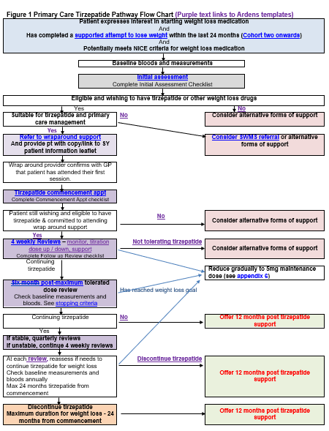
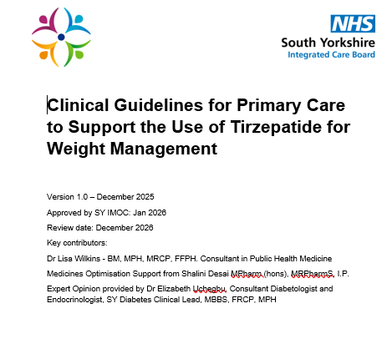
Pathway Flow Chart
SY ICB Medicines Optimisation

Slide 29
Step 2 Assessment
🩺 Medical History
• Review medical history and comorbidities – confirm date of the last diabetic eye screening and the result
• Screen for OSA (e.g., Epworth Score)
• Discuss contraception/OCP/HRT if applicable and clinical contraindications
🧠 Psychological & Behavioural Screening
• Assess psychological readiness i.e. Insight/motivation/coping style/ mental health/support and self-efficacy
• Screen for eating disorder risk – binge eating disorder very common
• Discuss prior weight-loss attempts
🎯 Goal Setting & Expectations
• Set weight & comorbidity goals
• Identify personal motivation
• Align expectations with realistic outcomes
🥗 Lifestyle & Dietary Review
• Review dietary patterns
• Assess baseline physical activity
• Identify lifestyle barriers
💊 Treatment Planning
• Agree medication plan & duration
• Discuss side effects & pancreatitis risk
• Confirm wrap-around support
⛔ Criteria for Continuation or Stopping
• Define expected treatment response
• Outline clear stop criteria
• Set follow-up & reassessment points

Slide 30
Initial Assessment Initial Assessment.docx
Baseline measurements: Ht, Wt, BMI, BP, Routine bloods – lipids, HbA1c, consider urea and electrolytes, LFTs, TFTs, B12/Folate, Ferritin etc
Confirm Eligibility, review medical history – check for any evidence of frailty, diabetes eye screening, diabetes care processes
Check and exclude contra-indications/extra precautions – pregnancy, planning pregnancy, past pancreatitis, gall stones, thyroid cancer , review medications
Assess co-morbidites – Screen for undiagnosed OSA, Eating disorders(use binge eating assessment tool - binge-eating-disorder-resource-kit-screener-7.pdf - refer to SYEDA if required, assess psychological readiness.
Shared decision making – wraparound care, weight loss goals, side effects(pancreatitis risk), contraception requirements, stopping criteria.
Counsel on key points – 2 years max duration, risk of weight regain

Slide 31
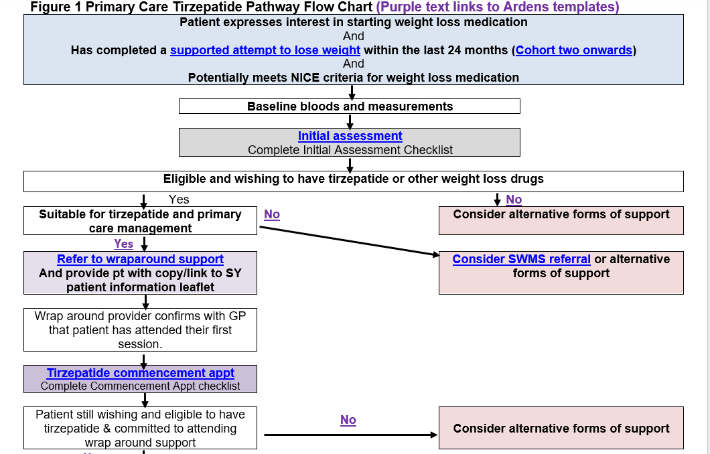

Slide 32
Step 3 Commencement Commencing tirzepatide appointment.docx
Confirm attended first appointment with wraparound care
Revisit dietary intake, level of physical activity, provide personalized dietary advice – aim for 1.2 to 1.6grams of protein per kg of ideal body weight or about 20 – 30% total calories to preserve lean muscle mass and support satiety.
Discuss importance of physical activity to preserve lean muscle mass – resistance training – assess severity of angina.
Patient already on 5mgs, can increase to 7.5mgs.
Provide Mounjaro Pen device training, sharps bin, appropriate size of pen needles.
Review medications and adjust accordingly – Diabetic Meds especially.
Discuss dose titration

Slide 33
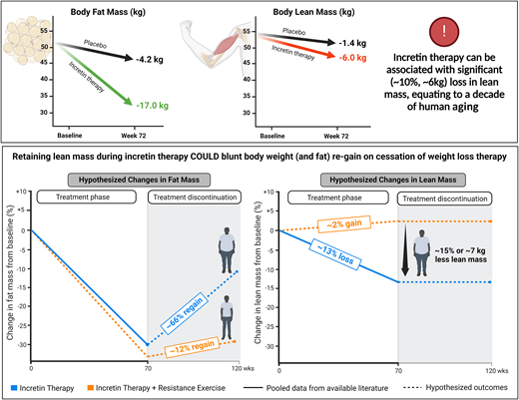

Slide 34
Case History 6
Mr TK
Age : 64years
Weight: 143kg ; Height 170cm; BMI 49.5kg/m²
PMH: Type 2 Diabetes, Hypertension, AF, OSA, OA, CKD 3, COPD, Curative Right Nephrectomy for Renal Cell Cancer in 2020, Painful Diabetic Peripheral Neuropathy, and Background Diabetic Retinopathy.
Medications: Novomix 30 32units am and 40units pm, Metformin 1 grams bd, Linagliptin 5mgs od, Dapagliflozin 10mgs od, Amlodipine 10mgs od, Ramipril 5mgs od, Atorvastatin 20mgs nocte, Inhalers, Gabapentin 300mgs tds, Edoxaban 60mgs od, Aspirin 75mgs od.

Slide 35
Case 6 - contd
BMI 49.5
BP 138/72mmHg
HbA1c 62mmol/mol(7.9%); eGFR >90mL/min
Lipids profile unremarkable, no past history of gall stones or pancreatitis, LFTs normal, TFTs normal, Haematinics, B12 and Folate were also normal.
Most recent eye screening 4 months ago - BDR
Weight goals – none – said he wants to lose enough weight to be less breathless and to move about more. Weight loss of 10–15% is typically the evidence-based target for the highest probability of stopping CPAP in obese patients with OSA.
Notes:
This slide is where I encourage a structured Tirzepatide initiation template, ideally embedded in EMIS or SystmOne. I usually say — ‘Baseline bloods, BP, weight, height, and eye screening confirmation are not optional — they’re commissioning expectations.’ Mention considering a pre-set Tirzepatide blood panel with biochemistry — it's a useful service development suggestion. It positions the practice as organised and reduces missed parameters later at audit

Slide 36
Stage pathway | Mins | First 12 months (4 weekly) |  |  |  |  |  |  |  |  |  |  |  |  | Second 12 months (quarterly)
 |  | 1 | 2 | 3 | 4 | 5 | 6 | 7 | 8 | 9 | 10 | 11 | 12 | 13 | 3 | 6 | 9 | 12
Initial Assessment | 30
Baseline measurements | 10
Commencement app | 30
Reviews & titration | 15
6 months max tolerated review | 20
Maintenance reviews | 15
Measurements/bloods | 10
Annual review | 20
NB: The timing of the six months post maximum tolerated dose review will vary between patients depending on how quickly they have been titrated and the maximum dose achieved. The appts coloured: Blue must be face to face appts (unless exceptional circumstances). Green - for the remaining 4 weekly reviews, it is up to clinical judgement and patient wishes as to whether some of them could be done remotely, with the patient recording their weight 4 weekly either at home or in the practice (e.g. if the practice has a weighing scale in the wating room). But as a minimum, the patient must be reviewed face to face and have a HCP recorded weight documented at least three monthly. Orange - If continuing tirzepatide beyond the six-month maximum tolerated review, a minimum of quarterly reviews face to face with HCP recorded weights are needed. Bloods and baseline measurements may be undertaken by a healthcare assistant. All other appointments must be undertaken by appropriately trained and qualified prescribing health care professionals.

Slide 37
Step 3 - Commencement
Confirm start date of wraparound care
Revisit dietary intake, level of physical activity, provide personalized dietary advice – aim for 1.2 to 1.6grams of protein per kg of ideal body weight or about 20 – 30% total calories to preserve lean muscle mass and support satiety.
Discuss importance of physical activity to preserve lean muscle mass – resistance training.
Start with the lowest dose for GLP 1 naive patients i.e. Tirzepatide 2.5mgs.
Provide Mounjaro Pen device training, sharps bin, appropriate size of pen needles.
Review medications and adjust accordingly – Diabetic Meds especially.
Discuss dose titration
Notes:
I emphasise here that initiation is not just handing a pen. I often say — ‘The start conversation is 70% mindset and 30% medication.’ Discuss wraparound care start date, dietary protein targets, and safe movement plans. I flag protein at 1.2–1.6g/kg ideal body weight, mentioning it's key to prevent sarcopenic weight loss. GPs often appreciate this practical metric as it gives them a concrete value to discuss rather than vague “eat more protein” advice

Slide 38
Step 3 –Initiation /review of medications
Mr AK
Novomix 30 32units am and 40units pm, - meets criteria for CGM , reduce am and pm insulin by 20 to 30%
Metformin 1 grams bd, - continue same dose
Linagliptin 5mgs od, - stop
Dapagliflozin 10mgs od, - continue same dose
Amlodipine 10mgs od, - continue same dose
Ramipril 5mgs od, - continue same dose
Atorvastatin 20mgs nocte, - continue same dose
Inhalers, - continue same regime
Gabapentin 300mgs tds, - continue same dose
Edoxaban 60mgs od, - continue same dose
Aspirin 75mgs od, - continue same dose

Slide 39
Step 4: 4 weekly reviews and titration
Week(s) | Dose (mg) | Frequency
Weeks 1–4 | 2.5 mg | Once weekly
Weeks 5–8 | 5 mg | Once weekly
Weeks 9–12 | 7.5 mg | Once weekly
Weeks 13–16 | 10 mg | Once weekly
Weeks 17–20 | 12.5 mg | Once weekly
Weeks 21+ | 15 mg | Once weekly
Standard rapid titration schedules are often not tolerated in real-world practice.
In my practice, I use a slower, tolerance-led titration based on individual response and side effects.
If the patient is losing more than 2kg per month, I maintain the current dose rather than escalating.
I only increase the dose once weight loss is < 1.5kg a month or the patient reports increased appetite.
Notes:
This is where I stress that textbook titration schedules rarely match real patients. I usually say — ‘The NICE leaflet suggests quick escalation, but in real life, people have jobs, nausea, and anniversaries — so titrate with humanity.’ I emphasise a tolerance-led approach: if they're losing >2 kg/month, pause escalation and consolidate. This reassures GPs that stability is as important as progress and prevents the common crash-then-regain cycle caused by rapid titration

Slide 40
Step 4 : Mr TK
Review at 4 weeks – overnight fasting glucose averages 6mmol/L – reported early morning hypo, before evening meal 8mmol/L. Checked BP 120/64mmHg. On NoVo mix 30 20units AM and 20units PM. Weight 140kgs. Starting to feel more hungry compared to the first week.
Action – Advised to reduce dose further to 18units AM and 16units PM.
Stop Dapagliflozin
Reduce the dose of Amlodipine to 5mgs OD
Increase the dose of Mounjaro to 5mgs SC OW
Notes:
Here I talk through Mr TK’s early follow-up. I say — ‘Notice how insulin adjustments happen before side effects force them — anticipatory deprescribing is safer and improves patient confidence.’ I highlight the reduction in Amlodipine dose too — reminding GPs that weight loss often improves BP, so antihypertensives may need review. This gives a strong clinical governance message: weight loss is not passive — it demands ongoing medication reconciliation."

Slide 41
Step 4: Mr AK Week 8
Review at 4 weeks – overnight fasting glucose averages 5.9mmol/L. Before evening meal 7mmol/L Checked BP 128/66mmHg. On NoVo mix 30 18units AM and 16units PM. Weight 137kgs. Slight nausea – manageable, constipated(laxatives prescribed), indigestion – no abdominal pain – PRN PPI Prescribed. LFTs requested.
Action: Continue same dose of Mounjaro 5mgs SC OW
Reduce AM Novomix to 16units AM and PM to 14units PM
PRN Laxatives
PRN PPI; Request LFTs
Notes:
This is a good slide to normalise GI effects. I usually say — ‘If a patient says they feel a bit nauseous but are still functioning, that's acceptable. If they're vomiting after every meal, that’s not “weight loss success”, that’s an escalation review.’ Advise GPs to be proactive: laxatives for constipation, PRN PPI for dyspepsia, LFT check if abdominal pain persists. It underscores the principle that weight loss should not come at the cost of nutritional harm or fear of eating

Slide 42
Step 4 – 4 weekly reviews up to 12months
Measure weight, calculate BMI, calculate percentage weight loss from baseline, measure BP, Review glucose profile.
Review diet, physical activity, engagement with wrap around care, any psychological issue, consider OTC vitamin and mineral supplement.
Review medications
Titrate dose according to rate of weight loss, aiming to minimize accelerated weight loss, guided by tolerance and side effects
Titrate to the maximum tolerated dose
Review at 6months on the maximum tolerated dose , review bloods
Notes:
Here I emphasise frequency and structure. I say — ‘Monthly in year one isn’t indulgence — it’s prevention of dropout.’ I highlight the need to measure percentage weight loss from baseline, not just total kilograms, to align with continuation criteria. I reinforce reviewing psychological response — some patients develop food anxiety as they lose weight, which NG246 wants us to identify early. This elevates the role of follow-up from admin to therapeutic review

Slide 43
Step 5 – Year 2
Most weight loss occur in the first year – often in the first 6 months.
In the 2nd Year review at 3 months, 6months, 9 months and 12months.
Begin focusing on weight maintenance strategies in year 2 , in preparation for stopping Tirzepatide at 24months.
Weight loss maintenance strategy
Notes:
Now I prepare the audience for a mindset shift. I say — ‘Most of the weight loss happens in the first year. Year two is a different clinical conversation — it becomes about weight stability, protein quality, muscle preservation, and emotional adjustment.’ I introduce the idea that preparing patients for medication exit at 24 months should start early — otherwise the stop date feels abrupt and distressing. This is where GPs become coaches rather than initiators

Slide 44
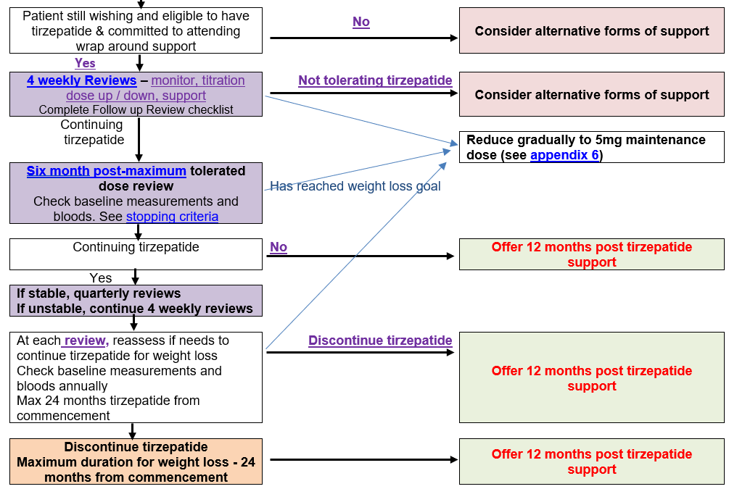

Slide 45
Practical guide for Tirzepatide dose titration
Start low (tolerability first): 2.5 mg once weekly for 4 weeks in GLP‑1- naïve patients - this dose is for GI tolerance, not efficacy.
If previously on GLP‑1: consider starting at 5 mg weekly only if previously well‑tolerated; still no faster than +2.5 mg every ≥4 weeks, individualise for age/frailty/comorbidity.
Standard titration: increase +2.5 mg every ≥4 weeks (2.5 → 5 → 7.5 → 10 → 12.5 → 15 mg); pause/hold if nausea/vomiting/diarrhoea and only escalate when stable/mild.
Also consider remaining on the same dose if rate of weight loss is more than 2pounds i.e. 1kg a week
Safe weight‑loss rate: aim ≤1 kg/week (frail/older adults ~0.5 kg/week) to reduce sarcopenia, falls and malnutrition risk.
Rapid loss = review trigger: >2 kg/week for 4 weeks → assess intake restriction, dehydration, GI pathology, malignancy/endocrine disease; pause escalation or down‑titrate.
Manage GI + protect nutrition: small frequent meals; avoid fatty/greasy foods, large volumes, alcohol/fizz; short‑term symptom meds if needed; reinforce protein + resistance exercise and consider multivitamin if low intake/frailty risk.

Slide 46
Examples of Foods with ~20g of Protein per Serving
Food | Portion Size | Protein (approx.)
Grilled chicken breast | 3 oz (85 g) | 26 g
Cooked salmon | 3.5 oz (100 g) | 22 g
Canned tuna | ½ cup (115 g) | 25 g
Extra-firm tofu | 1 cup (150 g) | 20 g
Greek yogurt (plain, nonfat) | 7 oz (200 g) | 18–20 g
Cottage cheese (low-fat) | ¾ cup (180 g) | 20–22 g
Lean ground beef (90% lean) | 3 oz (85 g) | 22 g
Pork tenderloin | 3 oz (85 g) | 22 g
Tempeh | 3 oz (85 g) | 16–20 g
Cooked lentils | 1 cup (200 g) | 18 g
Seitan (wheat protein) | 1 oz (30 g) | ~21 g
Protein powder (whey or plant-based) | 1 scoop (25–30 g) | 20–25 g
Notes:
I like to use this slide to pivot the conversation into practical nutrition. I say — ‘Rather than telling patients to “eat more protein”, give them tangible examples they can work with — 20g per meal is a useful anchor.’ I add — ‘This is not bodybuilder advice — it’s sarcopenia prevention.’ It helps reframe protein as part of medical therapy, not a lifestyle tip. I often mention that protein at each meal improves satiety, stabilises blood sugar, and makes weight maintenance much more achievable after stopping Tirzepatide

Slide 47
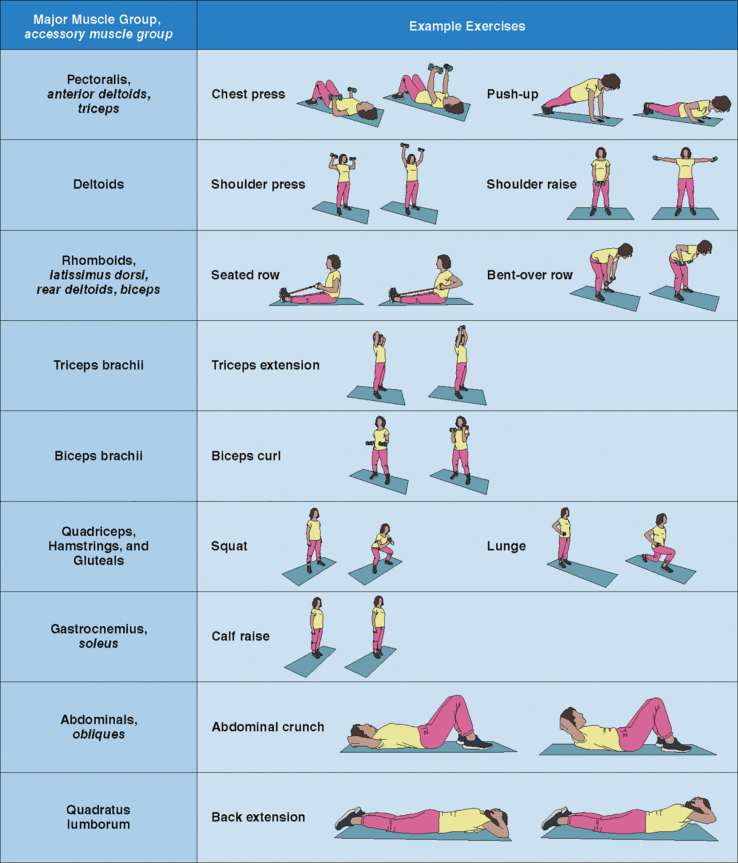

Slide 48


Slide 49
Step 5: MR AK Week 52
Weight reduced from 143kg to 121 kg, achieving a 15.4% total weight loss.
No longer requires CPAP; breathing has improved and walking tolerance has significantly increased.
NoVo mix 30 has been stopped — currently maintained only on Metformin 1 g BD, Amlodipine 5 mg OD, and Ramipril 5 mg OD; all other medications unchanged.
Tirzepatide titrated up to 12.5 mg SC once weekly — 15 mg dose not tolerated.
Tirzepatide Dose reduction discussed, but patient prefers to remain on 12.5 mg due to fear of weight regain.
Notes:
This is a powerful moment — I highlight that he achieved >15% weight loss, came off insulin, improved mobility, and even ceased CPAP — a real quality-of-life marker. I say — ‘These are the outcomes patients understand — being able to walk to the shop, breathe more easily, and carry fewer injections.’ It reinforces that Tirzepatide isn’t just about scales; it changes care plans and reduces polypharmacy. I note that sticking at 12.5 mg rather than pushing to 15 mg is an example of patient-led ceiling dose — autonomy matters.

Slide 50
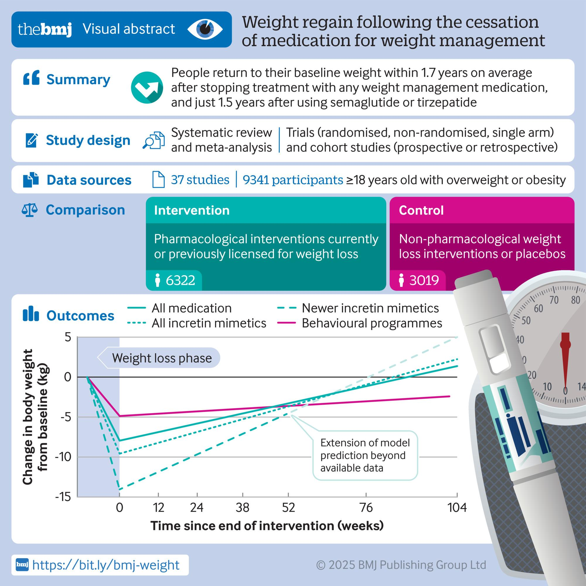

The Rebound is Real: What Happens When the Jab Stops
Sam West et al. BMJ 2026;392:bmj-2025-085304

Slide 51
Weight Loss Is Achievable. Weight Maintenance Is the Challenge
Rapid weight regain: average 0.4kg/month after cessation of weight loss medication; projected to return baseline weight by 1.7years.
Faster regain than behavioural programmes: 0.3kg/month faster weight regain vs lifestyle interventions , independent of initial weight loss.
Cardiometabolic benefits lost: HbA1c, Cholesterol, Triglycerides, BP all return to baseline within 1.4years.
Real-world discontinuation high: approx. 50% of people stop GLP-1RA within 12months in routine practice.
Behavioural support does not prevent regain: no evidence that post-cessation support slows down weight regain after weight loss medications.
Sam West et al. BMJ 2026;392:bmj-2025-085304

Slide 52
Weight Loss Maintenance Strategies
Strategy | Action/Outcome/Brief explanation
Physical activity | ≥150 min/week plus resistance exercises
Protein-rich, balanced diet | Satiety, muscle preservation, metabolic support
Self-monitoring | Weight/food/activity tracking
Habit-based behaviour change | Daily routines, meal planning
Mindful eating | Slow eating, hunger cues
Portion/calorie control | Conscious energy intake, avoid excess
Notes:
use this slide to offer practical advice rather than general slogans. I say — ‘NG246 wants structured maintenance plans — not “carry on as you are”.’ I highlight maintaining protein intake, encouraging resistance-based activity to preserve lean mass, and scheduling 3–6 monthly reviews even after active use. I remind GPs that relapse is expected and should not be treated as personal failure — this aligns with the ‘chronic relapsing condition’ framing

Slide 53
Take Home Points
Tirzepatide is highly effective but requires careful patient selection, comprehensive initial assessment and mandatory wraparound support
Weight regain is rapid after stopping – counsel patient that this is a chronic disease management, not a short-term fix
Follow SY Pathway , seek specialist advice if needed
Manage expectations early – discuss 24-month max duration, contraception requirement and lifestyle commitment from the outset
Tirzepatide/Weight loss medications is only one tool in multidimensional weight management

Slide 54
Additional Optional Educational Sessions
Tirzepatide for Weight Management in Primary Care - Understanding the Behavioural Support for Obesity Prescribing (Wrap Around Support).
Wednesday 4th March, 12:30-13:30.
Register here: Microsoft Virtual Events Powered by Teams
This information session will support practices across South Yorkshire to understand and promote the Behavioural Support for Obesity Programme (BSOP), also known as the Wrap Around Support. Delivered by Reed Wellbeing
The webinar will cover:
The BSOP options available for eligible service users
A clear overview of the patient journey, from referral to programme delivery
Key talking points to help staff confidently introduce BSOP during appointments
Time for Questions and Answers
How to refer into the programme
Diet and GLP1s
Carla Gianfrancesco RD, MSc
Diabetes Specialist Dietitian
Sheffield Diabetes and Endocrine Centre
Date TBC
Recognising eating disorders
SYEDA
TBC

Slide 55



Resources
SY ICB Medicines Optimisation
SY Position Statement on the use of tirzepatide for overweight and obesity
SY ICB Clinical Guidelines for Primary Care to Support the Use of Tirzepatide for Weight Management
SY ICB Quick Reference Guide: Clinical Guidelines for Primary Care to Support the Use of Tirzepatide for Weight Management
SY ICB Patient information leaflet – available soon
NICE Implementation Resources:
Tools and resources | Tirzepatide for managing overweight and obesity | Guidance | NICE
Includes:
Tirzepatide A discussion aid for healthcare professionals and patients
A practical guide to using medicines to manage overweight and obesity
Pharmaceutical company resources website:
uk.lilly.com/metabolic/hcp/diabetes/mounjaro/resources
Include videos and leaflets on how to inject

Slide 56


