Slide 1



Welcome - We will start at 12:30
Sheffield Area Prescribing Group – Learning Lunch
6 February 2025
Sheffield Medicines and Prescribing

Slide 2


Introductions
Emily Parsons - Medicine Safety Officer
Sharron Kebell – Specialist Commissioning Pharmacist
Diana Vasile - Lead Pharmacist (Strategy & Delivery Sheffield-Place)
Barbara Obasi - Clinical Effectiveness Lead Pharmacist
House Keeping

Slide 3
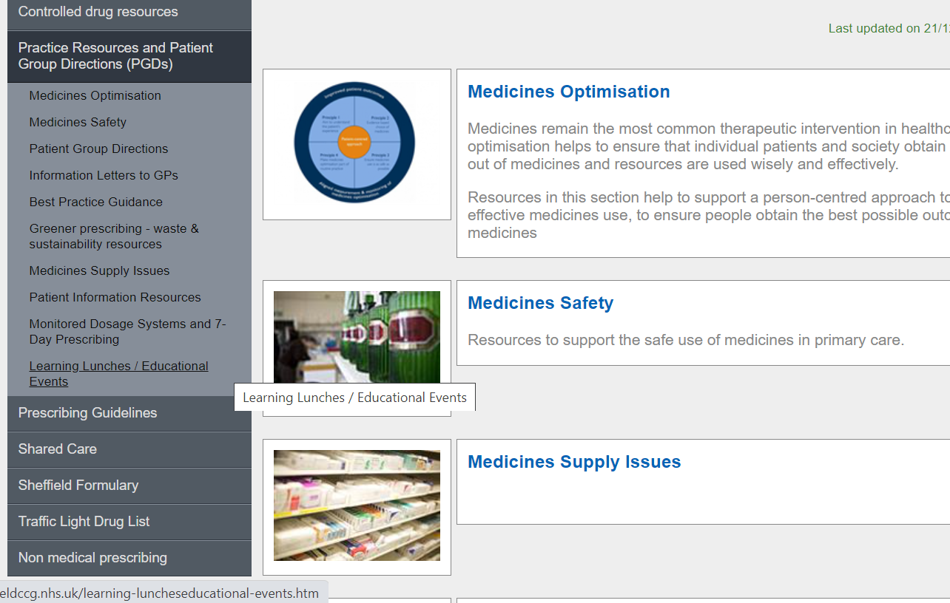
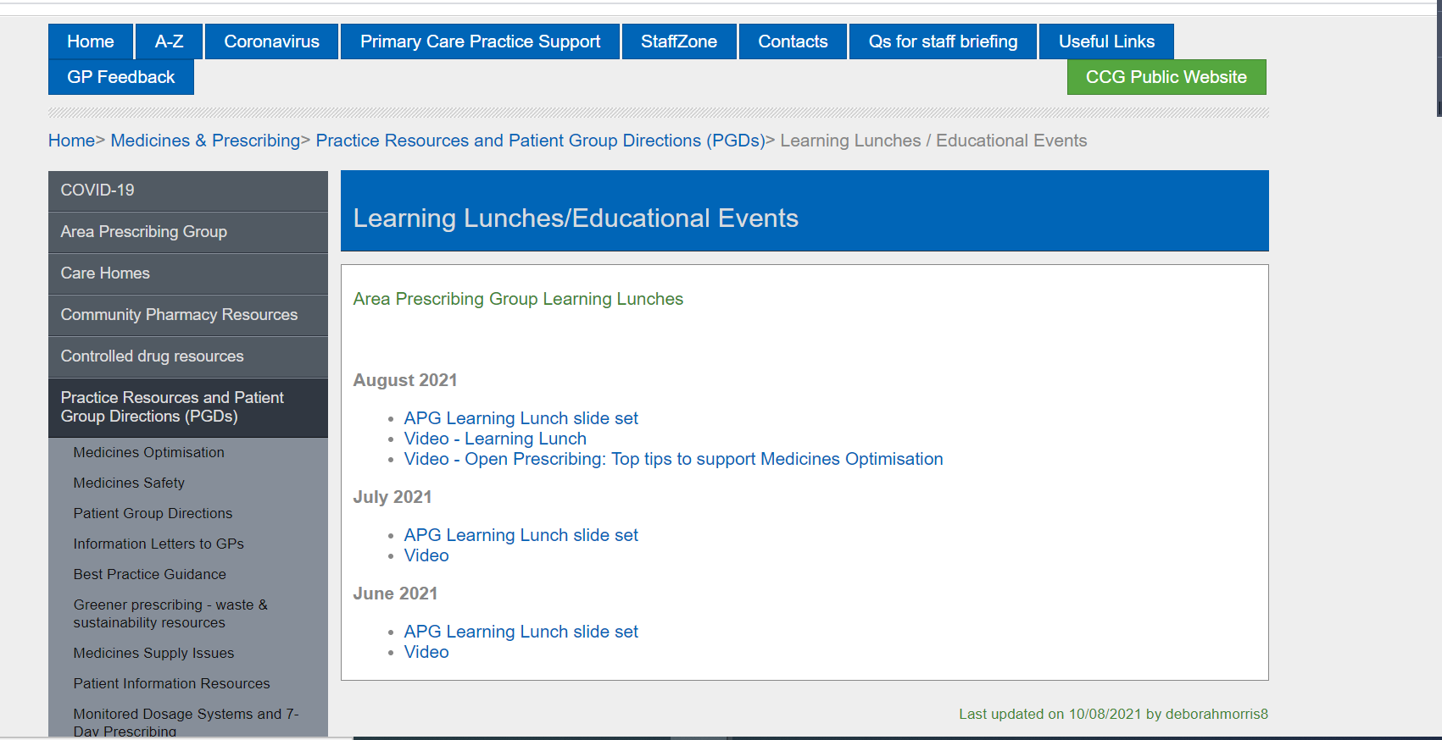
Missed the meeting/other learning lunch resources
https://www.intranet.sheffieldccg.nhs.uk/medicines-prescribing/learning-luncheseducational-events.htm

Slide 4

Learning objectives
To be aware of latest updates & suggested actions:
IMOC Approved Traffic Light Drug List
Analysis of DMARD Clinical System Searches
Medicines Supply issues
  Salazopyrin EN ® / Sulfasalazine Supply Issue
  Estradot patches
Clinical Guidelines
  Progestogens for endometrial protection when using HRT: Guidance for Sheffield Primary Care
Formulary Chapter Update
  Chapter 4
  Chapter 6
Medicines Safety update
Education &Training opportunities

Slide 5


Traffic Light Drug List
Drug | Indication | SY ICB Traffic Light Status
Levodopa + carbidopa + entacapone (new intestinal gel formulation) | Treatment of advanced Parkinson´s disease with severe motor fluctuations and hyperkinesia or dyskinesia when available oral combinations of Parkinson medicinal products have not given satisfactory results | RED (1,6)
Midazolam (licence change from use only in infants, children and adolescents) | Treatment of prolonged, acute, convulsive seizures in adults, adolescents, children and infants aged ≥3 months | AMBER (1,3)
Vibegron (new medicine) | Symptomatic treatment of adults with overactive bladder syndrome | GREEN
*** Please note: SY ICB GREY TLS is equivalent to BLACK on Sheffield’s TLDL***
To access both SY ICB TLDL and Sheffield place TLDL: Sheffield place intranet > Medicines and Prescribing > TLDL
Optimise Rx will be updated with all IMOC approved TLDL changes.
Avoid adding any RED medicines prescribed by hospital to patient’s repeat record. Add as ‘hospital only drug’

Slide 6
Analysis of DMARD Clinical System Searches – A Reminder
Background:
DMARD (clinical system) searches (DMARD toolkit) have been developed by IT & MOT and are published on SystmOne & EMIS web.
They identify whether:
  a patient is monitored / reviewed in primary care or secondary care
  the relevant monitoring has taken place
  the records are being coded appropriately
  there is a robust recall system in place to ensure appropriate monitoring is taking place
The Sheffield DMARD monitoring template uses codes that are consistent with the DMARD toolkit searches, and (unlike the Ardens DMARD templates) it aligns with the current Sheffield DMARD shared care protocols (SCPs)
N.B. There are issues with the availability of test results (the ICE download saga), communication from other providers, completeness of entries made by practices – and all of these contribute to the results of the Toolkit

Slide 7
MOT in 2023 supported GP practices with the following:
Discussed the Sheffield DMARD monitoring template and DMARD toolkit with key GP practice personnel involved with DMARDs, to promote awareness, advantages, how to access and how to use.
Provided GP practices with a snapshot as to whether patients are up to date with current blood monitoring of DMARDs by running the DMARD toolkit searches and reviewing at least 10 patients on DMARDs in each practice
Ensured that GP practices are testing for extended LFTs and CRPs, so signposted GP practices to short cut on ICE via “Primary care sets”
Discussed the results of the searches and analysed / highlighted any patients overdue/ any anomalies with the GP Prescribing Lead

Slide 8
Interventions / Problems with Shared Care of DMARDs
Patient identified as being overdue with blood monitoring or incorrect test ordered (e.g., LFTs ordered instead of extended LFTs) .
Patient prescribed methotrexate by the GP without record of a shared care agreement in clinical records
Dose of methotrexate changed by rheumatologist, but methotrexate continued to be prescribed by primary care at old dose
Methotrexate stopped by secondary care, or not ordered for several months, but remained on repeat template
Leflunomide in addition to blood monitoring needs BP checking every 3 months
Coding inconsistencies in relation to how DMARD reviews are coded on clinical system

Slide 9
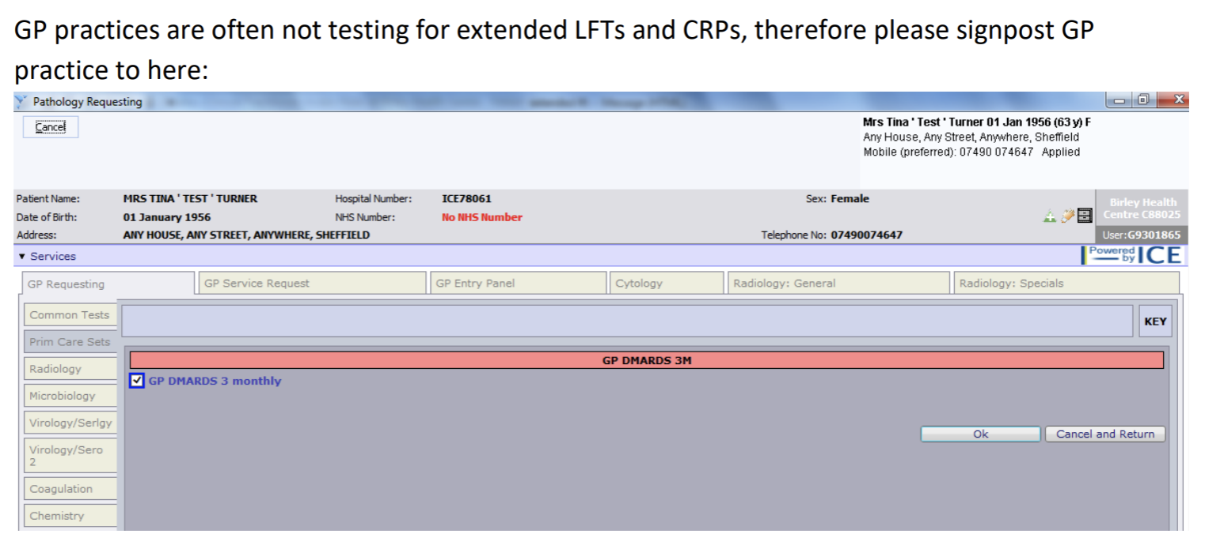
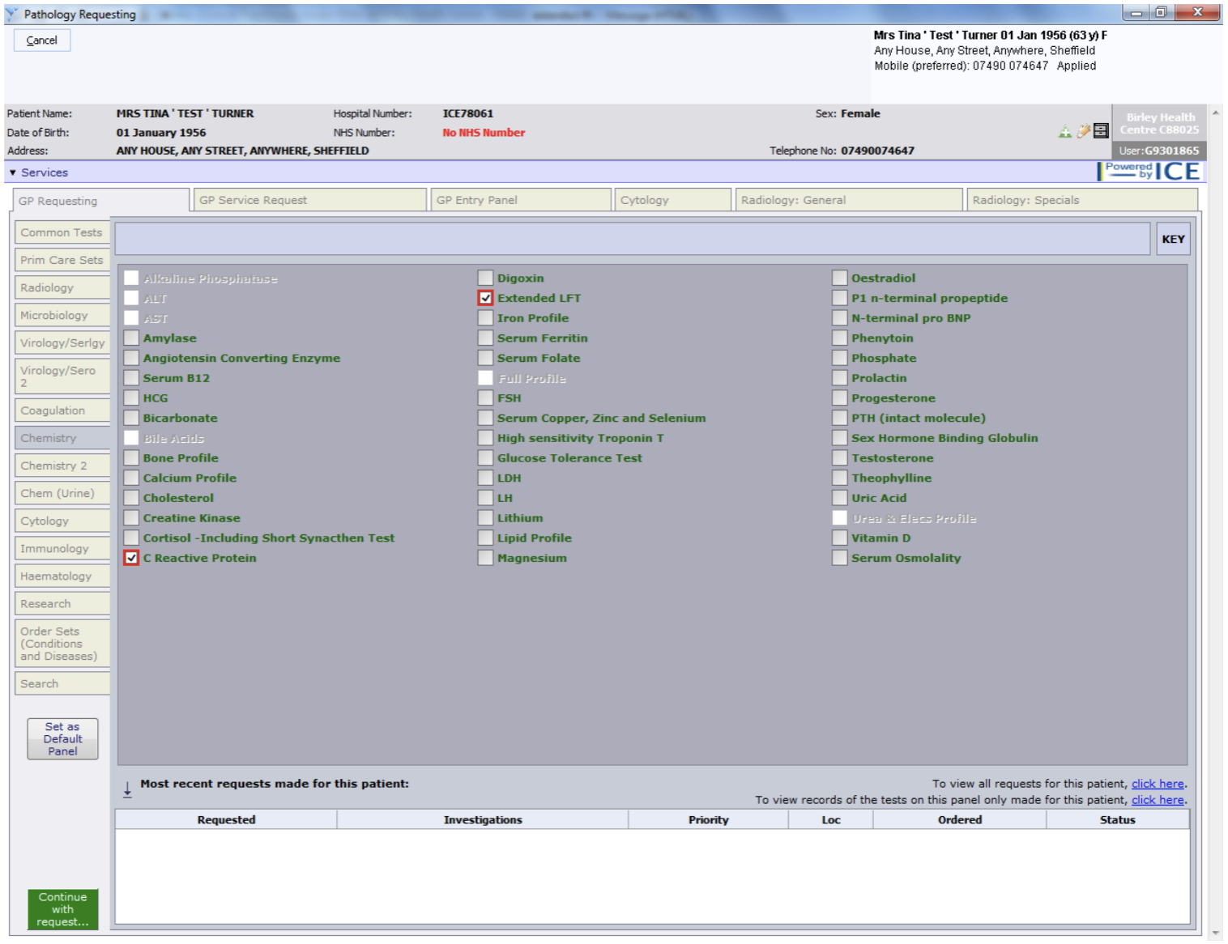
Interventions / Problems with Shared Care of DMARDs

Slide 10
Results
Completed across 60 GP practices in Sheffield, 1811 patients on DMARDs were reviewed by the MOT, but please note that this was just a snapshot and not all patients

Slide 11

Next Steps
Please get in touch with MOT if you wish to repeat the exercise / or did not complete at the time and we can signpost you to resources.

Slide 12
Salazopyrin EN ® / Sulfasalazine Supply Issue
Salazopyrin (sulfasalazine) range discontinued and replaced with generic versions
The tablets and gastro-resistant tablets are produced by several manufacturers. An oral suspension and suppository are also available. Oral products are not expected to have significantly different release profiles.
the following are available - (prices from Drug Tariff)
  Sulfasalazine 500 mg gastro-resistant (GR) tablets- (generic) - £26.97 for 112 - category M, N.B price has reduced from £70
  Sulfasalazine 500 mg plain tablets – (generic) - £4.87 for 112
Sulfasalazine 500mg plain tablets are ONLY licensed for inflammatory bowel disease (IBD)
Sulfasalazine 500mg GR tablets are licensed for IBD and rheumatoid arthritis
Local (STH) rheumatology specialists only support use of GR / EC in their patients
Sulfasalazine Shared Care Protocol Patients with rheumatoid arthritis, and those treated over a long period with NSAIDs, may have sensitive stomachs and for this reason enteric-coated sulfasalazine (Salazopyrin® EN-Tabs) are recommended for this disease,
N.B. Sulfasalazine is not generally started by gastro-enterologists; it just tends to be used when patients also have concomitant rheumatoid conditions.
Consider switching patients currently prescribed Salazopyrin EN ® to sulfasalazine GR /EC

Slide 13
Medicine Supply Issues –Estradot patches
Estradot 50, 75,100 microgram patches.
https://www.sps.nhs.uk/shortages/shortage-of-estradiol-estradot-50micrograms-24-hours-75micrograms-24-hours-and-100micrograms-24-hours-transdermal-patches/
Anticipated resupply date:
100mcg: 7 Feb; 75mcg: 17 Jan, but no stock in local wholesalers as of 31 Jan; 50mcg: 28 Feb.
There is an SSP in place to supply an equivalent strength of Evorel or Estraderm MX transdermal patches:
https://www.nhsbsa.nhs.uk/pharmacies-gp-practices-and-appliance-contractors/serious-shortage-protocols-ssps
Some individuals may prefer to mix and match Estradot patch strengths, rather than have an alternative patch. Other strengths are 25 and 37.5 micrograms currently no supply problem with these. If these strengths are prescribed, ensure this is issued as an acute.

Slide 14
Progestogens for endometrial protection when using HRT
Guidance for Sheffield Primary Care
Guidance approved by APG Jan 2025
www.intranet.sheffieldccg.nhs.uk/Downloads/Medicines%20Management/prescribing%20guidelines/Progestogens.pdf
Based on BMS guidelines and local recommendations, including Sheffield Formulary progestogen choices.
Is complementary to the SYB Cancer Alliance: Guidance for patients on HRT with unscheduled bleeding
https://syics.co.uk/application/files/3417/2372/6971/Guidance_for_patients_on_HRT_with_unscheduled_bleeding_Vs_3.0_SY_Cancer__Alliance.pdf
Further information will be presented at March Learning Lunch

Slide 15
Chapter 4: Central Nervous System – interim update
Chapter 4 of the Sheffield Formulary has had an interim update to ensure all content for valproate and topiramate accurately reflects the recent regulatory changes, including information on of each of the Pregnancy Prevention Programmes.
See: 4. Central nervous system - June 2026
There have been no changes to all other content in Chapter 4.
Changes can be found in sections
  4.2.3 Drugs used for mania and hypomania
  4.7.4.2 Prophylaxis of migraine
  4.8.1 Control of epilepsy
Links have been provided to all new or updated guidance documents containing valproate and/or topiramate that were approved at SY IMOC in November 2024. These include:
  SCP for Epilepsy in Adults
  SCP for Epilepsy in Children
  South Yorkshire Valproate Guidance
  Topiramate review flowcharts

Slide 16
Chapter 6: Endocrine System
Section 6.1.1.2 Intermediate and long-acting insulins UPDATE
Insulatard® (isophane insulin, human) Penfill® 100units/ml suspension for injection 3ml cartridges is being discontinued by March 2025 with stock anticipated to be exhausted by June 2025. Please see MSN/2024/112 for more info. The Insulatard vials remain available and listed on the formulary but are used less commonly in Sheffield.
Supportive information containing advice on the management of patients currently using this insulin has been produced in collaboration with the Sheffield Diabetes Specialist Services and circulated to all the Sheffield PCN pharmacy teams on Friday 13th of December 2024. Information can be re-circulated if necessary.
Send an e-mail to Diana at diana.vasile@nhs.net, to request.
If switching in practice:
2 reusable pens to be provided on switch/first prescription: one for use and one spare.
please note the insulin pen needles do not need to change and generic insulin needles will work with each of these pens. However, if not using 4 mm or 5 mm consider changing to the shorter length (occasionally longer needle lengths have been chosen for a specific reason so this will need to be discussed with your patient).
Insupen Original needle is the first line option on the Sheffield Place Formulary.
Please refer the patients who have the insulin administerd by a nurse to the Community Diabetes Specialist Nurse Team.
Please review patients who are prescribed the discontinued insulin line.

Slide 17
Medicines Safety
National Patient Safety Alerts (NatPSAs)
Shortage of Pancreatic enzyme replacement therapy – Additional actions: action required by 31st January 2025
This alert contains actions which are in addition to those outlined in the NatPSA (NatPSA/2024/007/DHSC) issued on 24th May 2024.
There are limited supplies of pancreatic enzyme replacement therapies (PERT).
  Creon® 10,000 and 25,000 capsules remain in limited supply until 2026.
  Nutrizym® 22 capsules and PancrexV® capsules and powder are intermittently available but are unable to fully cover the gap in supply.
The alert provides further background, clinical information and actions for providers.
A SY mitigation plan is being finalised to support instances when patients are unable to obtain stock from their community pharmacy.
In Sheffield, the information previously presented at the APG Learning Lunch in September 2024 still applies – See APG Learning Lunch slide set.
MHRA and other national alerts
Class 2 Medicines Recall: Wockhardt UK Limited, WockAIR160 microgram/4.5 microgram, inhalation powder, EL(24)A/62
Wockhardt UK Limited is recalling this batch as a precautionary measure following the identification of a low number of units which may have a defect in the 'top case' resulting in a dose not being able to be dispensed.
GLP-1 and dual GIP/GLP-1 receptor agonists:potential risk of pulmonary aspiration during general anaesthesia or deep sedation
GLP-1 and dual GIP/GLP-1 receptor agonists are known to cause delayed gastric emptying, which may increase the risk of residual gastric contents despite preoperative fasting.
Healthcare professionals should be aware of the potential risk of pulmonary aspiration in patients using GLP-1 or dual GIP/GLP-1 receptor agonists who undergo surgery or procedures with general anaesthesia or deep sedation.
Remind patients to inform their healthcare teams and anaesthetists if they are on GLP-1 or dual GIP/GLP-1 receptor agonists. When used for aesthetic weight loss patients may not readily disclose this information unless directly asked. Be aware that private prescriptions may not always be included in the patient’s medical notes or drug history.

Slide 18
Medicines Safety (continued)
MHRA and other national alerts
TriOnPharma recalls Vitamin D3 2000iu/ml supplements (AactiveD3) because of excess levels
TriOnPharma is recalling AactiveD3 Drops and AactiveD3 Solution because they contain higher levels of vitamin D3 than stated on the label. Customers are advised not to take them, and to return them to the store from where they were bought.
MHRA warns against buying weight loss medicines without a prescription
MHRA issued a press release reminding the public not to buy weight-loss medicines without a healthcare professional’s prescription from beauty salons or via social media due to serious health risks. It also highlights that it is against the law to sell medicines in this way.

Slide 19

Education and Training
Managing prescribing in heart failure
Session 1: Master the complexities of heart failure medications. Learn how to tailor therapy for individual patient needs.
Wednesday 26th February 2025, 1pm-2pm
All registered subscribers can sign up here
South Yorkshire ICB already subscribes to PrescQIPP, which means you can access a vast range of evidence-based, quality assured resources absolutely free.
Sign up to PrescQIPP today
Flyer for practice/PCN pharmacists and pharmacy technicians

Slide 20
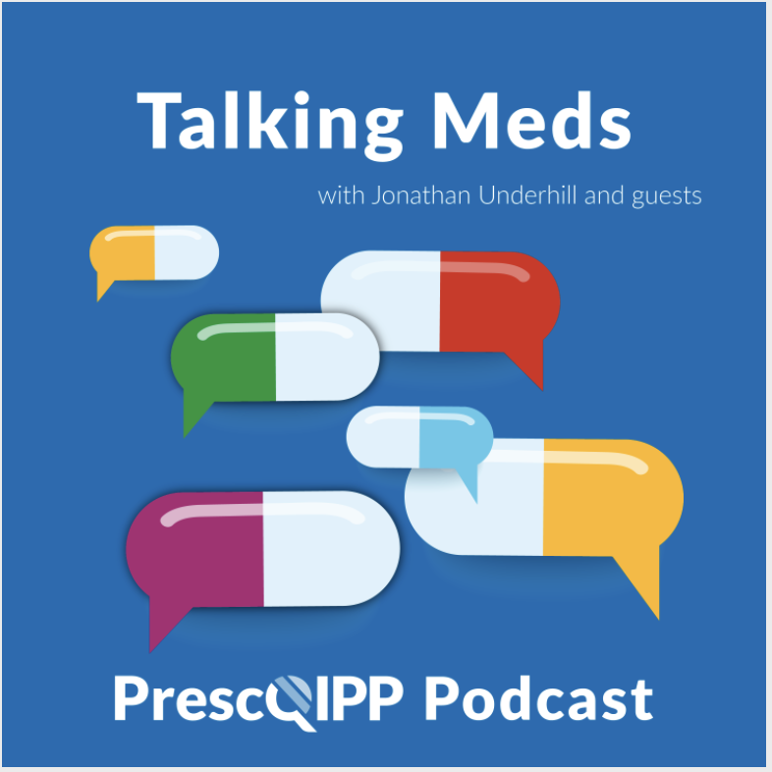
Education and Training
Talking Meds is available to listen to via your usual podcast system and a new episode will come out every fortnight, on the first and third Friday of each month.

Slide 21
Summy Key actions
Summary of key Actions
Add
Add any RED medicines prescribed by hospital as ‘hospital only medicines’ – not on repeat. Please share with colleagues to refer to SY ICB and Sheffield’s TLDL until the unification process is complete.
Check out
Check out learning opportunities (all of which are free to attend)
Familiarise
Familiarise yourself with medicines safety updates
Consider
Familiarise
DMARD Reviews: Please contact the MOT if you wish to repeat the exercise / or did not complete at the time and we can signpost you to resources.
Familiarise yourself with the formulary chapter 4 and 6 updates
Consider
Consider switching patients currently prescribed Salazopyrin EN ® to sulfasalazine GR /EC
Watch out
Further information on the Sheffield Primary Care Guidance on Progestogens for endometrial protection when using HRT will be presented at March Learning Lunch

Slide 22
Next APG– Learning Lunch
Thursday, 6th March 2025
click here to join the meeting
Feedback welcome.
Feedback forms can be found here

Slide 23
APG– Learning Lunch 2025 dates
Thursday 6th March click here to join the meeting
Wednesday 16th April click here to join the meeting
Thursday 8th May click here to join the meeting
Thursday 5th June click here to join the meeting
Thursday 3rd July click here to join the meeting

Slide 24

If there are any issues you would like to raise or report to Sheffield Area Prescribing Group, please send these direct to the APG mailbox: syicbsheffield.areaprescribinggroupsheffield@nhs.net

